Slide 1
Naan Mudhalvan Final Project
Team Members: Janani Shanmugi M A,Akshaya Shree S
Register Number: 813821104050,813821104009
Department: Computer Science And Engineering

Slide 2
PROJECT TITLE: Breast Cancer Classification using Neural Network

Slide 3


AGENDA 1.project title 2.problem statement 3.project overview 4.who are the end users 5.solution and its value preposition 6.The wow in our solution 7.modelling 8.results
3/21/2024 Annual Review

Slide 4

PROBLEM STATEMENT The aim of this project is to develop a robust neural network model for the classification of breast cancer tumors into benign and malignant categories based on various features extracted from diagnostic images or patient data.

Slide 5

PROJECT OVERVIEW 1. Data Collection and Preprocessing 2.Model Development 3. Model Training and Evaluation 4. Hyperparameter Tuning 5. Interpretability and Visualization 6. Deployment and Integration

Slide 6

WHO ARE THE END USERS? 1.Medical professionals 2.Patients 3.Researchers 4.Healthcare institutions

Slide 7

MY SOLUTION AND ITS VALUE PROPOSITION Neural networks can effectively learn complex patterns and relationships within medical imaging data, resulting in high accuracy in distinguishing between malignant and benign tumors. This leads to more reliable diagnoses and reduces the risk of misclassification.

Slide 8

THE WOW IN MY SOLUTION 1.Early detection of cancer 2.Personalized Medicine 3.Speeding up the diagnosis process 4..Scalability and Accessibility for accurate diagnosis
3/21/2024 Annual Review

Slide 9
MODELLING programming language:python algorithm:neural network frameworks: numpy Pandas matplotlib Sklearn.model_selection Sklearn.datasets

Slide 10
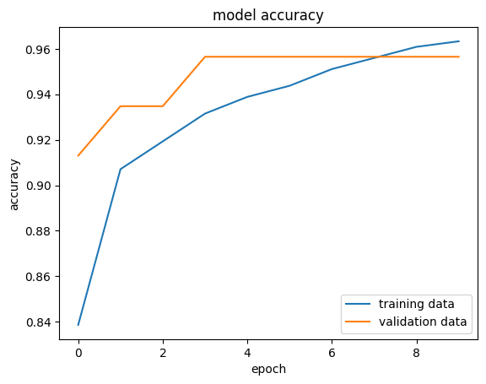
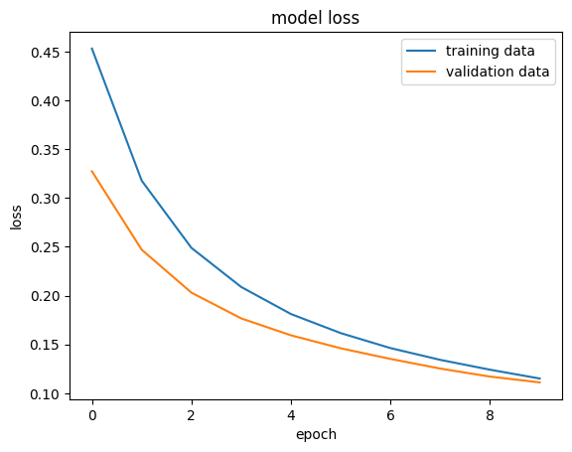
RESULTS

Slide 11
RESULTS

